Slide 1
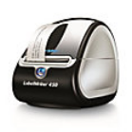
Reference Guide for DYMO
Label Writer 450 Turbo Printer
Different labels will not stay affixed to
Frozen cryovials.
Only use APOLLO study “specific labels” as follows:
Diversified Biotech: Catalog No. DTCR-7000
USA Scientific: Direct Thermal Cryo-Tags,
2.00”x0.75” 500/roll (white)
For Thermal printers: Catalog No. 9138-7000
Click slide show mode on you own Powerpoint software to initiate audio
Notes:
This is an instructional guide showing how to set up and use the DYMO printer. It will demonstrate how to install software for the DYMO printer an how to create and print APOLLO labels. This guide as well as label templates will be available on the public face of the apollo website. No log-in is required. You can also print these slides to use as an instructional reference.
Dymo software should be loaded on the same computer that will be used to print the labels. So, if someone in your lab is printing the labels for you they will need to install the software on their computer.
One important note to mention about the labels is that we request you only use the study designated labels listed on this slide. These labels are designed to stay affixed to -80 degree frozen tubes.
Please do not use the labels that came in the box with your DYMO printer.

Slide 2
To download software for the DYMO printer use the link below For Windows: https://www.dymo.com/en-US/dymo-label-software-v873-windows For Mac: https://www.dymo.com/en-US/dymo-label-software-v873-mac Use Internet Explorer as Default Browser The software (v8.7.3) must be downloaded on the computer you (or your lab) will be using to print labels. ONLY use this version, do not upgrade to newer versions.
Notes:
The link to download the DYMO software is located on this slide. You will need to follow the correct link for your operating system.
You should use Internet Explorer as the browser to download this software. If you have previously downloaded this using Google Chrome there is no need to re-do the download... you can simply continue using the software as always.
However, please do not upgrade to newer versions of the software. Only use version 8.7.3.
So now we will click on the link or (copy and paste) the link into internet explorer to start the download process.

Slide 3
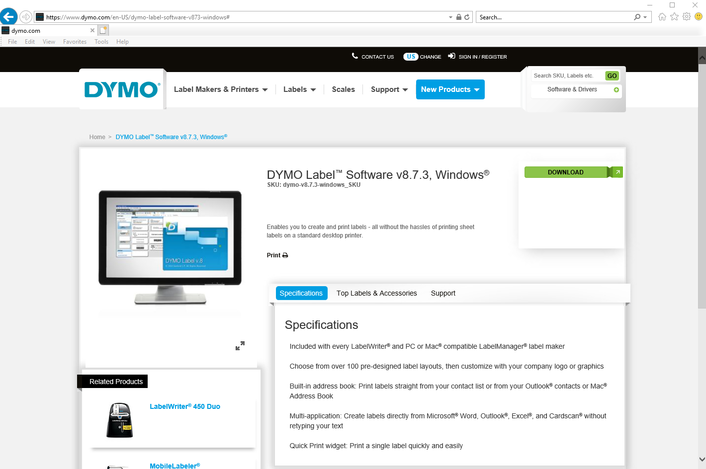
DYMO website
Click here to download software
Notes:
The following slides (3-11) will demonstrate the sequence of steps to download the software. Notice the software version is 8.7.3.
Click Download as indicated.

Slide 4
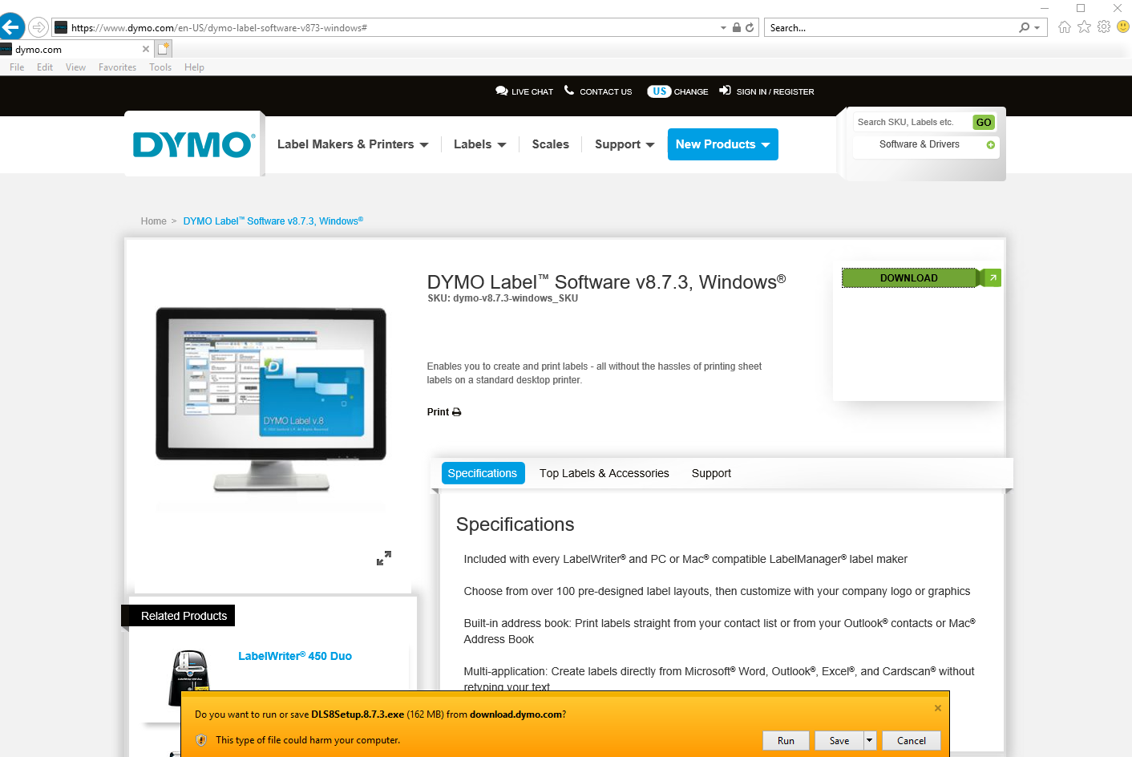
Click RUN
Notes:
Continue the process as indicated

Slide 5
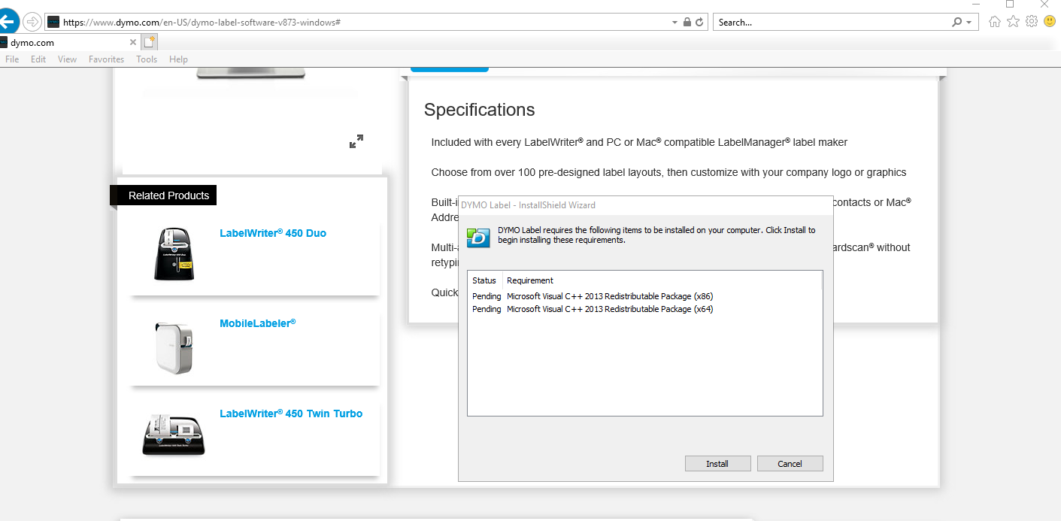

Slide 6
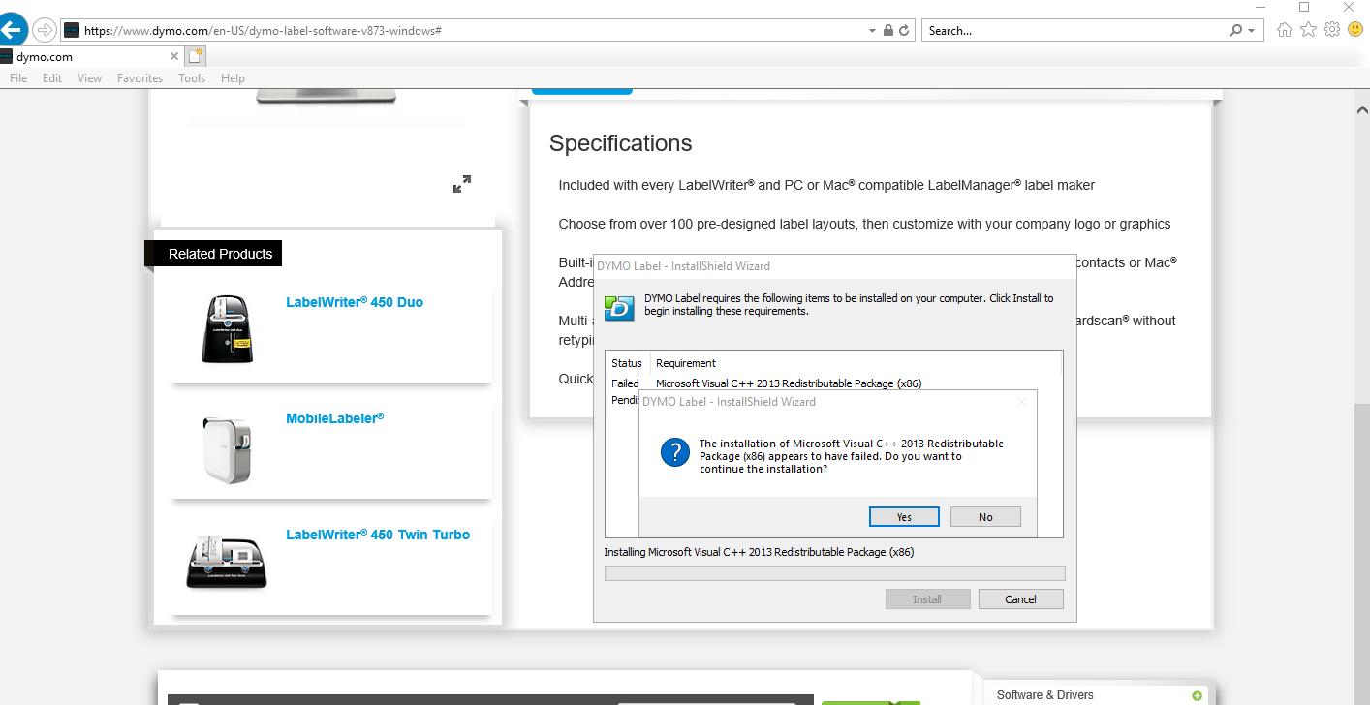
Notes:
Continue to follow the displayed steps.

Slide 7
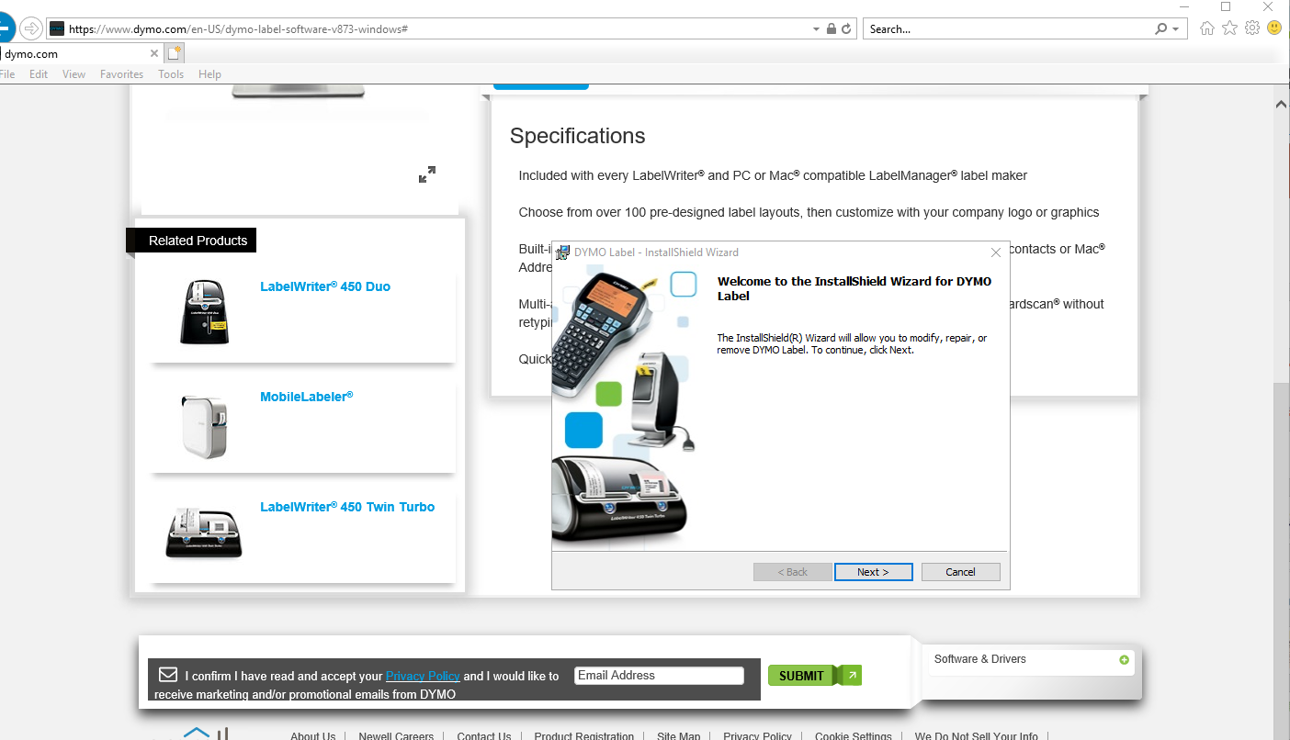
Notes:
Continue as indicated

Slide 8
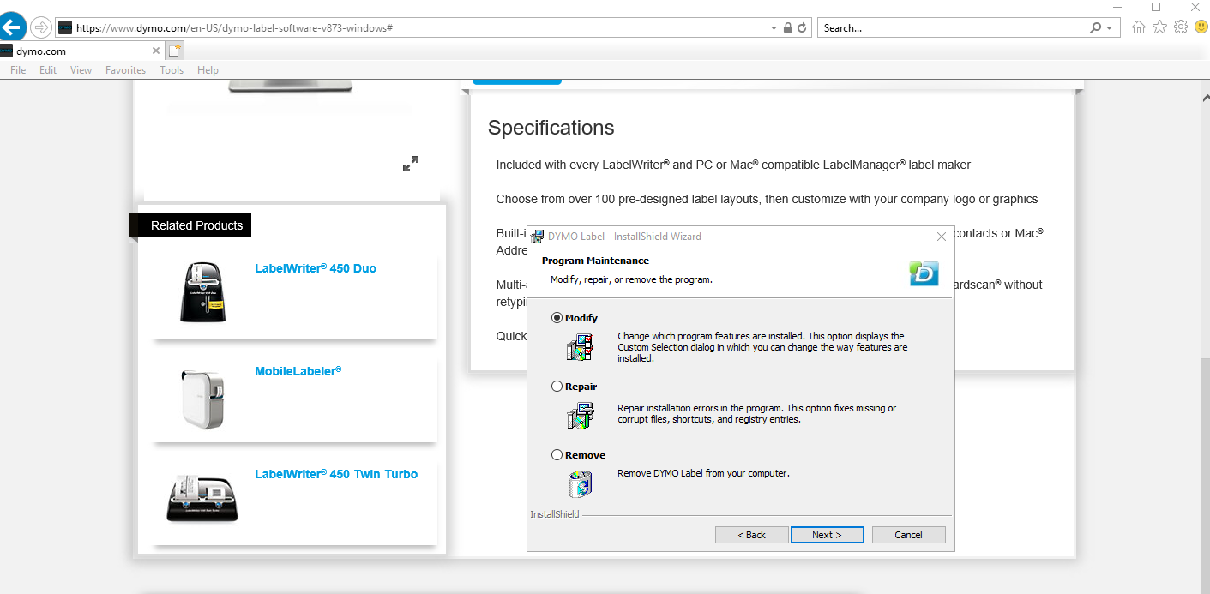
Notes:
Leave the Modify bubble indicated and click next

Slide 9
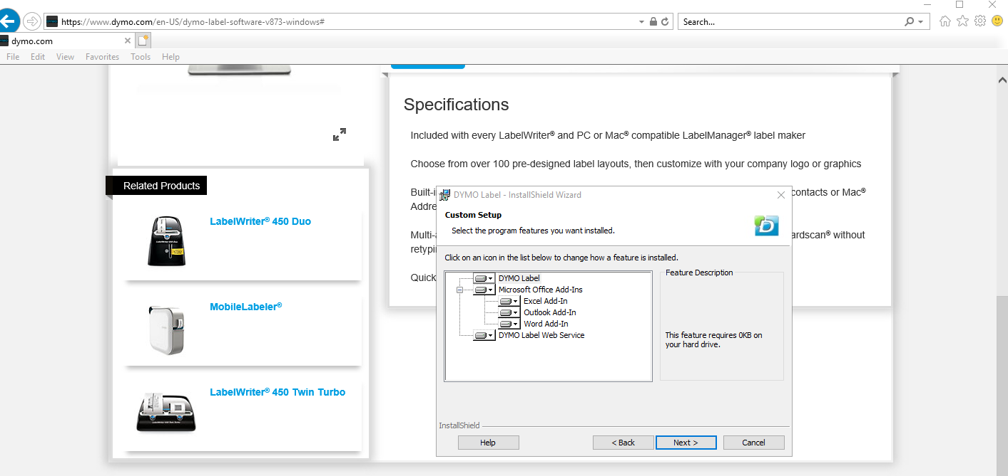
Notes:
Click Next

Slide 10
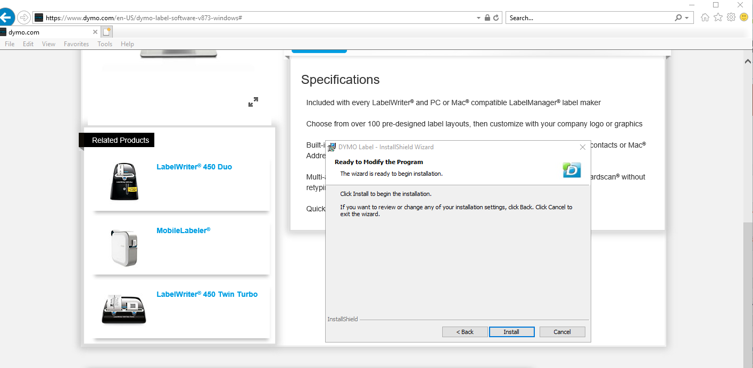
Notes:
Click install

Slide 11
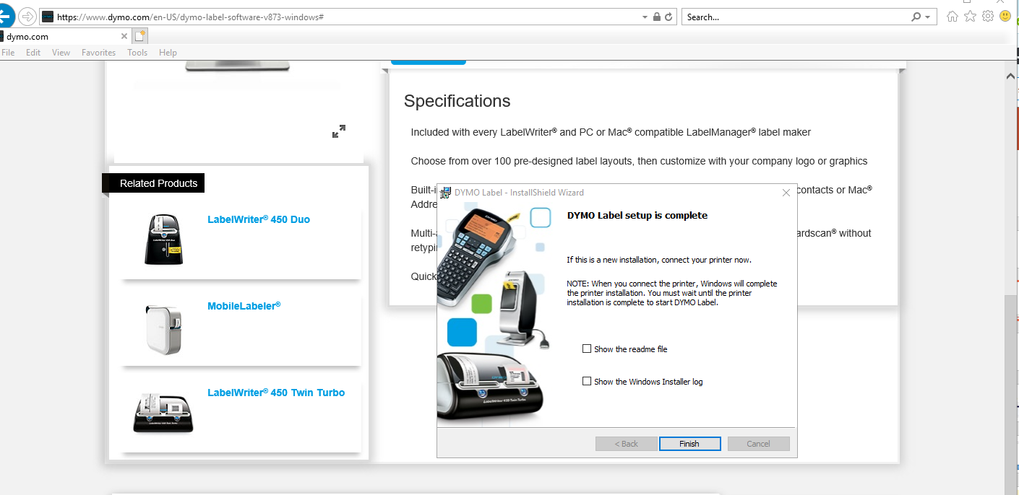
Notes:
If this is an new installation, you should connect your DYMO printer now and then click Finish to complete.
We have provided pre-formatted template files to be used for all APOLLO labels. After the installation of this DYMO software you will be able to open and use these templates each time …without specifically having to open the software.

Slide 12
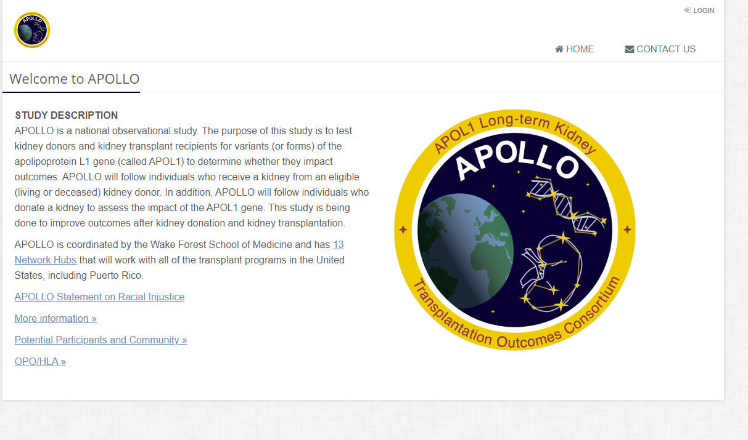
Label Templates (for RECIPIENTS AND DONORS) are located on the public page of the APOLLO website…
theapollonetwork.org
Log in is not required
Address
DYMO Printer
Notes:
You can go to the apollo website to download both the study specific label templates.
Once you arrive at the APOLLO website, you will see DYMO printer listed at the bottom, simply click here to find both the label templates.
One is for recipients and the other is for donors.

Slide 13
These templates can only be opened when the DYMO printer is turned on
and plugged into the USB port of the computer
Notes:
Click on each file to download them to your desktop. Once they are downloaded you can edit them to match your assigned transplant center code.

Slide 14
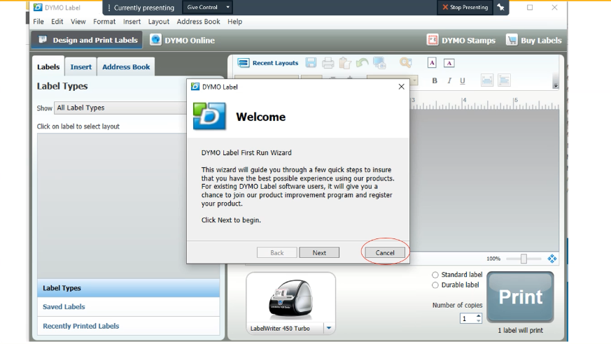
The first time the software
opens on your computer, the
system will want you to
Run the wizard. Instead,
click on the cancel button.
Do not run the wizard
Notes:
The first time the software opens on your computer, the system will want you to RUN the wizard. Instead, click on cancel.

Slide 15
**The Goal is to
Edit these templates so they are specific to your site by changing the transplant center code to match your site code)
Save the corrected file so each time you open it (in the future) the correct center code will be displayed
IMPORTANT:
Do not change the size, font or format of these labels!
You will only need to change the text.
One label is for
Recipients = REC
One label is for
Donors = DON
Notes:
This is what a printed label should look like. The important thing to remember is not to change the size, the font or format of these labels. They are designed to specifically fit our APOLLO tubes.

Slide 16
Choose the correct (downloaded) label template file to create a label for a… Recipient or Living Donor?
Recipient Label Template
Use Transplant Recipient Record # (TRR) located on UNOS website in TIEDI.
TRR # is currently a 6-digit number starting with a 8. (May change to a 6-digit number starting with a 9 in the future).
Do Not use a match ID or local ID number for a recipient.
Living Donor Label Template
Use official UNOS ID #
Format is: ABCD123 or ABC1234
Notes:
When you need to create labels for a participant, make sure you are using the correct template... Either a recipient or a donor, and make sure you are entering the correct information for each.
so...
If it is a ...
recipient:
You should use the TRR# Transplant Recipient Record # , which is found on the UNOS website in TIEDI.
The format is currently a 6-digit number starting with a 8, but it may change in the future to a 6 digit number starting with a 9. Do not use a match Id or local ID.
However, if it is a living donor .. you should use the official UNOS ID #, and the format is shown here with letters followed by numbers.

Slide 17
How do I edit the label templates?
*Always remember, it’s a 2-step process
1.
2.
Double Click on QR code to edit information
Contents shown on
Next slide
Click once on the text
to edit information
Information must be edited in both places for every participant !
Notes:
We have received many incorrectly labeled samples so we want to go through the process of editing the label to be used for your participant. There are two places where the label needs to be edited.
1. in the QR CODE or the black and white box.. double-click in the box to change the information there and then you would
2. (single click) in the actual text field to change the information there.
Each label must be changed in both of these places every time. This is important because ...when the SDRC receives the sample it will be scanned using the QR code and it should match the text.

Slide 18
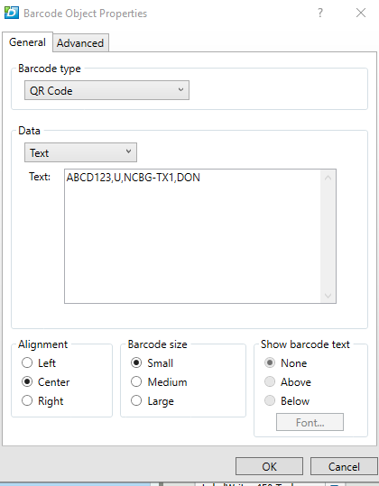
This is the window that
Is displayed when you double
click on the QR code.
When editing information
Do not remove the commas
and do not put in any blank
spaces.
UNOS ID
For donors
Sample Source:
DON=Donor
REC=Recipient
Sample Type
U=Urine
S=Serum
D=DNA
Center ID
Make sure you have
chosen the correct
template for…
Donor=DON or
Recipient-REC
Change to your
assigned center
code. NCBG is only
an example.
Click OK when done
Notes:
This is the window that is displayed when you double click on the black and white QR code.
This slide clarifies the different sections of the required entry.
The important thing to remember is not to remove any of the commas and do not put in any additional spaces.

Slide 19
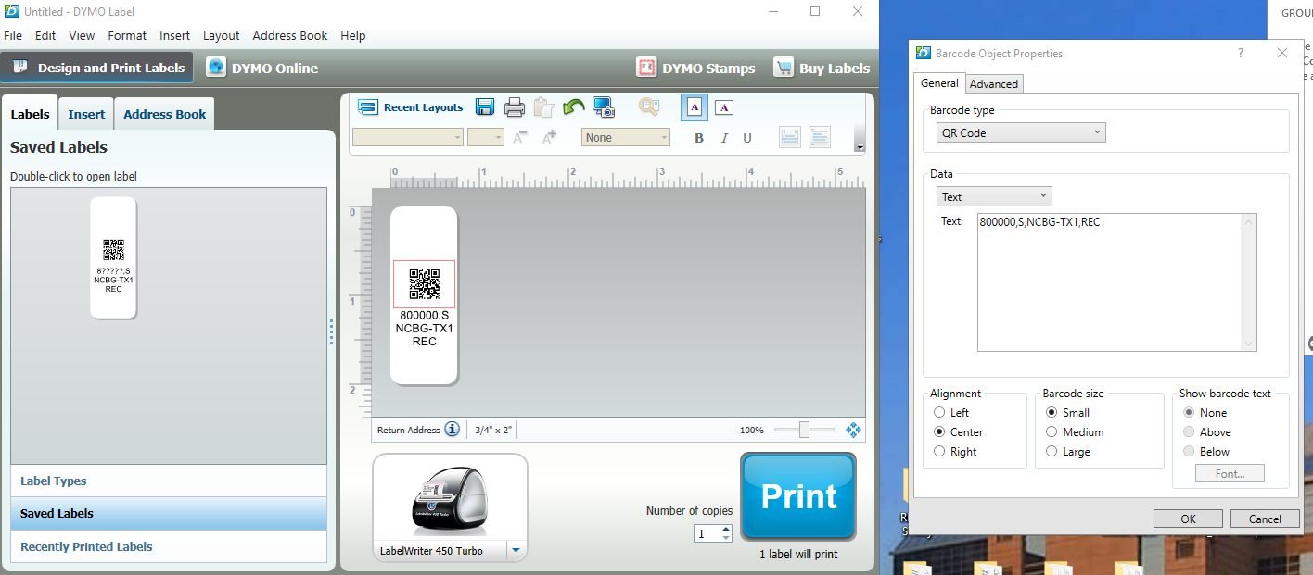
Check matching entry before you print
QR code text field
Label text field
Compare both entry fields
We ask that you compare the entries to ensure they match
Notes:
Before you print your labels, we recommend you compare your entries to ensure they match in both the text field. of the label and the QR code field.

Slide 20
Lets review what needs to be changed on the label?
This is an example of editing
Text for a recipient label.
Before you save the file make the following change…
*Remember to make change in both places … in QR code and text
The next time you open your saved template to create a participant label to print make only the following changes….
*Remember to make changes in both places … in QR code and text
NCBG-TX1 is only an example
of a center code.
Change the center code
To match your assigned code.
Since this is a recipient label, you
will need to edit the TRR# and sample
type… your center code should already
be correct if you changed it and
saved it as described.
Sample Types
S=serum (print 12)
U=Urine (print 12)
D=DNA (print 1)
To avoid wasting labels, we recommend printing one label to check accuracy before printing the remaining.
Once corrected you can
save the template file
DO NOT CHANGE FORMAT OR TEXT SIZE
Notes:
So Lets Review...
this slide demonstrates what needs to be edited before the file is saved ... which is the txp center ID Code specific to your site.
Then each time you open the file (after that) the center code will be correct. In this case you will only need to change the participant ID (either TRR# or UNOS ID#) and the sample type. The sample types are listed on this slide...
S=Serum
U=Urine and D=DNA
we recommend you print one label to check for accuracy before printing the remainder of the required labels.
Again, remember to make your changes in both places.

Slide 21
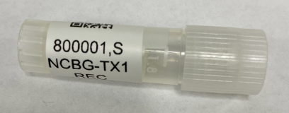
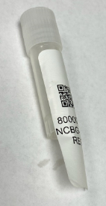
Affix printed labels perpendicular
to cryovial (as shown)
X
Notes:
We have received samples with the label applied incorrectly and we have received labels that have been cut to fit.
Please affix the APOLLO specific labels to the vials as demonstrated at the top of this slide and do not cut the labels.
Again, use only the APOLLO designated labels for study samples.

Slide 22
Please share these slides with your engaged coordinators or non-study lab staff.
Notes:
We ask that you share this training review with your engaged sites as soon as possible so the errors can be corrected as quickly as possible.
And, as always please contact us if you have any questions or any problems with labels.
Thank you

